Slide 1

Macroeconomic Transformation
Davide Chengrui Xie – Fabian Bellgardt – Ianina Tarca – Ildem Demir – Tomas Carzolio Legeren

Slide 2
Today’s Agenda
Economic Situation
Critical Issues
Economic Reforms
Recommendations

Slide 3
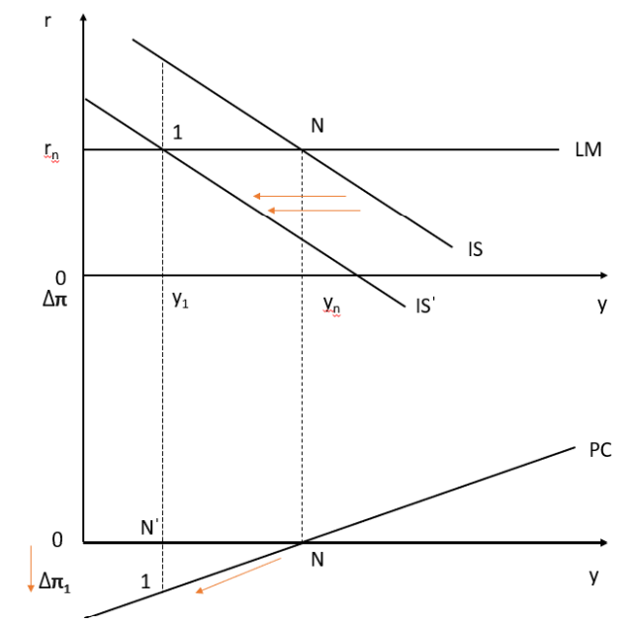
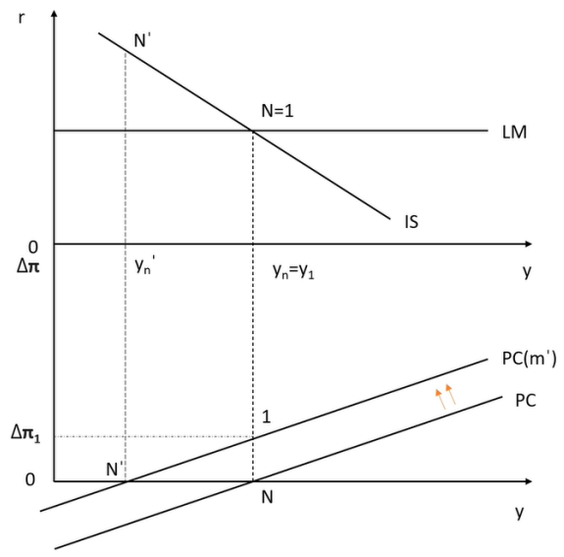
1. Economic Situation
Present
Past Decade
European context
COVID-19
Ukraine War
GDP: 50.6% consumption, 23.7% government spending. 68.3% service, 20.7% industry.
Unemployment: 5.6%, between lowest and highest points
Debt % GDP: 106%, fiscal concerns
Inflation: Increased to 9.6%
GDP: regular ascent, real GDP increase 15.7%, nominal GDP increase 41%. averagely, 69.1% service.
Unemployment: record low in April 2020, 4.9%
Debt % GDP: downward trend disrupted by Covid-19 and Ukraine War.
Inflation: decrease until 2021, followed by sharp increase
Unemployment: same trends, wages indexed to inflation might cause issues
Debt % GDP: higher compared to others
Inflation: similar trends, average 2.6% in Belgium, 2% in Eurozone
GDP: growth rate –5.3% due to limitations on service sector
Unemployment: increased
Government-debt-to-ratio: 14% increase
Energy Crisis: major supply cut, Belgium prepared
GDP: decrease by 6.7%, positive output gap
Unemployment: increased, real wage in Europe decreased

Slide 4






2. Critical Issues
Pensions and Inflation
Climate change
High pension cost in public spending: projected 11.5% of GDP for 2023.
Damage to infrastructure, human health, tourism sector competitiveness, energy demand.
Record levels of inflation: 9.6% in 2022-2023
Energy transition relies heavily on electricity
Inflation on energy prices and wage indexation
National Energy and Climate Plan
Debt ratio and public deficit
Keynesian economic approach
High government spending
Unbalanced public finances
Current deficit:
4.9% of GDP
High borrowing costs
Reduced fiscal credibility

Slide 5


3. Economic Reforms
Tax reform
Pension reform
Climate Change reform
National Pact for Strategic Investments
Labor → consumption taxes
Tax-free amount ↑, adjustment of tax bracket
Global Minimum Tax
Notional interest deduction
Increase in retirement age
Pensions bonus
Doubling of ‘Wijninckx’
Sustainable energy sources
Investments in ’greener solutions’
Resilience plan for COVID-19
150 billion euros investment by 2030
Infrastructure, digitalization, energy, health, education
Aimed at innovation, job creation, and support for green and digital transitions

Slide 6



4. Recommendations
Charting the Future: Fiscal Reform and Green Energy in Belgium
Binding Fiscal Framework
Reducing Wage Indexation
Hub for Renewable Energy
National Climate Commission
Navigating the complexity of the federal composition
Different Priorities in the various regions
Improving Fiscal Framework based on 2013 Cooperation Arrangement
Implementing a gradual reduction of wage indexation
Reduces public deficit by opening up additional funds for other uses
Decrease of public deficit leads to a decrease in borrowing costs
Hub in Europe for renewable molecules based on hydrogen production
Invest in offshore wind production
On the matter of climate change, there must be coordination between state and federal governments.
2002: National climate commission

Slide 7
Thank You

